Slide 1


Slide 2

View the Slides
https://github.com/kyre6371/rmacc_2025/slurm_verification

Slide 3

Introduction – Why Configuration Matters
Misconfigured SLURM settings often lead to user confusion, job failures, and a spike in support tickets — creating friction for both researchers and support staff.

Slide 4
The Problem
Validating SLURM configs is painful
Manual checks are error-prone
You only get feedback after something breaks

Slide 5
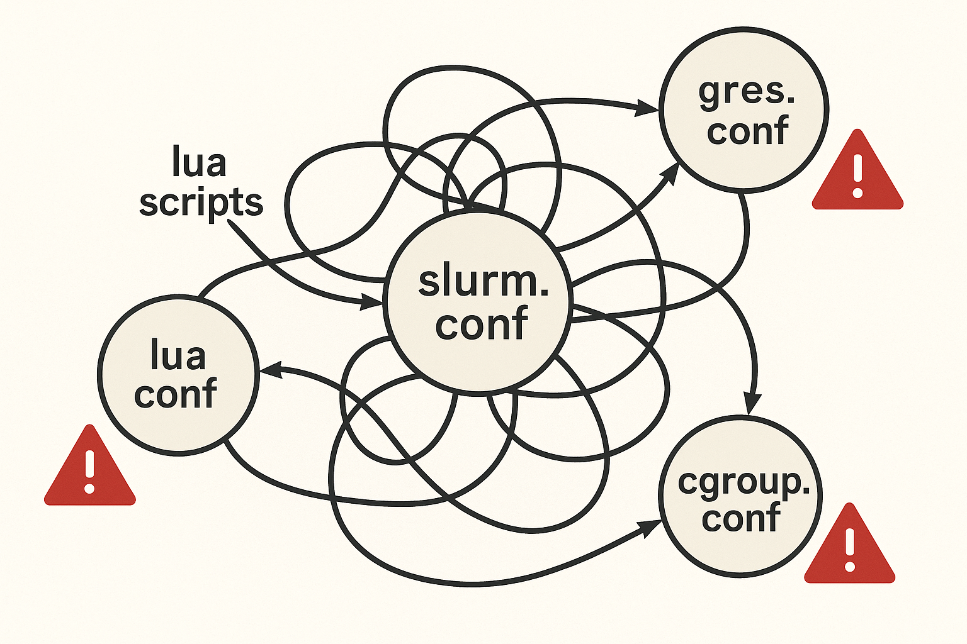
The Problem

Slide 6
Current Approaches
Manual Reviews — Time-consuming and error-prone
Cluster-Specific Scripts — Custom, hard to reuse or share
Limited Tooling — scontrol, slurmlint, UBCCR simulator offer partial checks

Slide 7

An Approach to SLURM Configuration Verification
Declarative validation schemas (e.g. JSON schema for YAML-like configs)
Automated testing pipelines
Community-driven validation rules
Notes:
What if we could

Slide 8









Products Utilizing Schema Validation

Slide 9
Conclusion
Config correctness is essential → current tools fall short → better tooling is possible
Email - kyle@colorado.edu

Slide 10
Prior Art in SLURM Configuration Checking
https://github.com/appeltel/slurmlint – amazing work, does not use a schema, last updated 2019
https://ubccr-slurm-simulator.github.io/ - incredible project for simulating configurations, supports Slurm 17.11 – is currently being updated
Spin up slurm controller in a container and see if fails
“If it crashes, it's not right” – Joe Malingowski

Slide 11
Limitations with Current Approaches
Don’t scale well
Hard to generalize
Not integrated into CI/CD

